Slide 1
Detailed BI Architecture
Part 1
Week 1: January 19, 2017
Professor: Steve Conrad

Slide 2
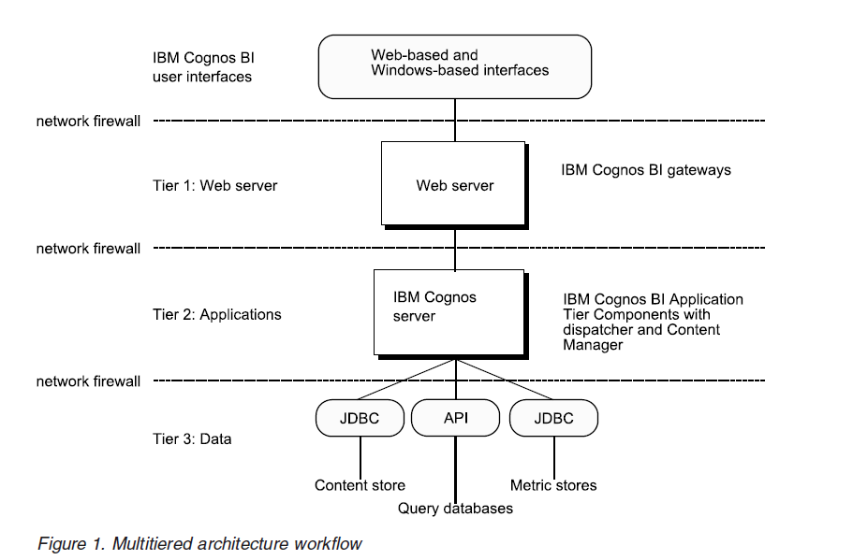
IBM Cognos High Level BI Architecture
Source: IBM Cognos Business Intelligence Version 10.2.2: Architecture and Deployment Guide

Slide 3
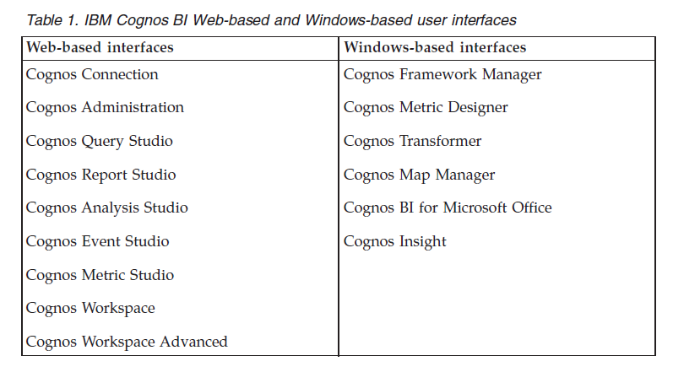
IBM Cognos BI Architecture – Detail
User Interfaces
  Web-based
  Windows-based
  Custom - SDK
Source: IBM Cognos Business Intelligence Version 10.2.2: Architecture and Deployment Guide

Slide 4
IBM Cognos BI Architecture – Detail
User Interfaces
  Web-based
  Windows-based
  Custom - SDK
Source: IBM Cognos Business Intelligence Version 10.2.2: Architecture and Deployment Guide

Slide 5
IBM Cognos BI Architecture – Details
Tier 1 – Web Server: IBM Cognos BI Gateways
When an IBM Cognos BI gateway receives a request, it
    encrypts passwords to ensure security
    extracts information needed to submit the request to an IBM Cognos BI server
    attaches environment variables for the Web server
    adds a default namespace to the request to ensure that the server authenticates the user in the correct namespace
    passes requests to an IBM Cognos BI dispatcher for processing Gateway
Source: IBM Cognos Business Intelligence Version 10.2.2: Architecture and Deployment Guide

Slide 6
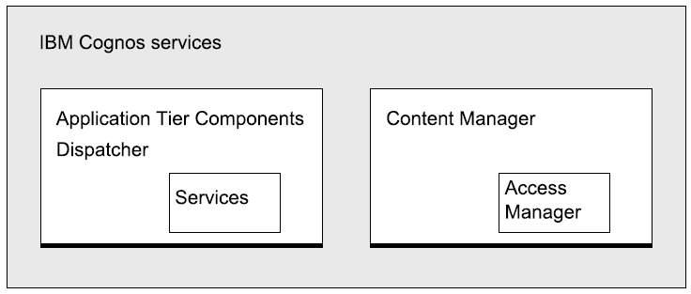
IBM Cognos BI Architecture – Details
(see diagram posted on Blackboard)
Tier 2 – Applications: IBM Cognos BI Servers
Dispatcher – operates services and routes requests
Content Manager – manages IBM Cognos BI information (metadata)
Source: IBM Cognos Business Intelligence Version 10.2.2: Architecture and Deployment Guide

Slide 7
IBM Cognos BI Architecture – Details
(see diagram posted on Blackboard)
Tier 3 – Data: Content Providers
Content Store – a relational database that contains data that your IBM Cognos BI product needs to operate, such as report specifications, published models, and the packages that contain them; connection information for data sources; information about the external namespace, and the Cognos namespace itself; and information about scheduling and bursting reports.
Data Sources - include relational databases, dimensional or OLAP cubes, flat files, and other physical data stores.
Metric Store – “a relational database that contains content for metric packages. A metric store also contains Metric Studio settings, such as user preferences.”
Note: Data Sources will sometimes be referred to as query databases or operational databases but the term data sources is a better generic term.
Source: IBM Cognos Business Intelligence Version 10.2.2: Architecture and Deployment Guide

